Slide 1

3D Slicer 2-Day Workshop
The George Washington University
4/1 & 4/3

Slide 2
Learning Objectives
After this workshop you should be familiar with how to…
Import CT scans from image stacks
Visualize 3D data and generate graphics
Segment CT scans and generate models
Analyze and measure morphology
Use SlicerMorph for 3D geometric morphometrics
Utilize resources to keep learning about 3D Slicer

Slide 3
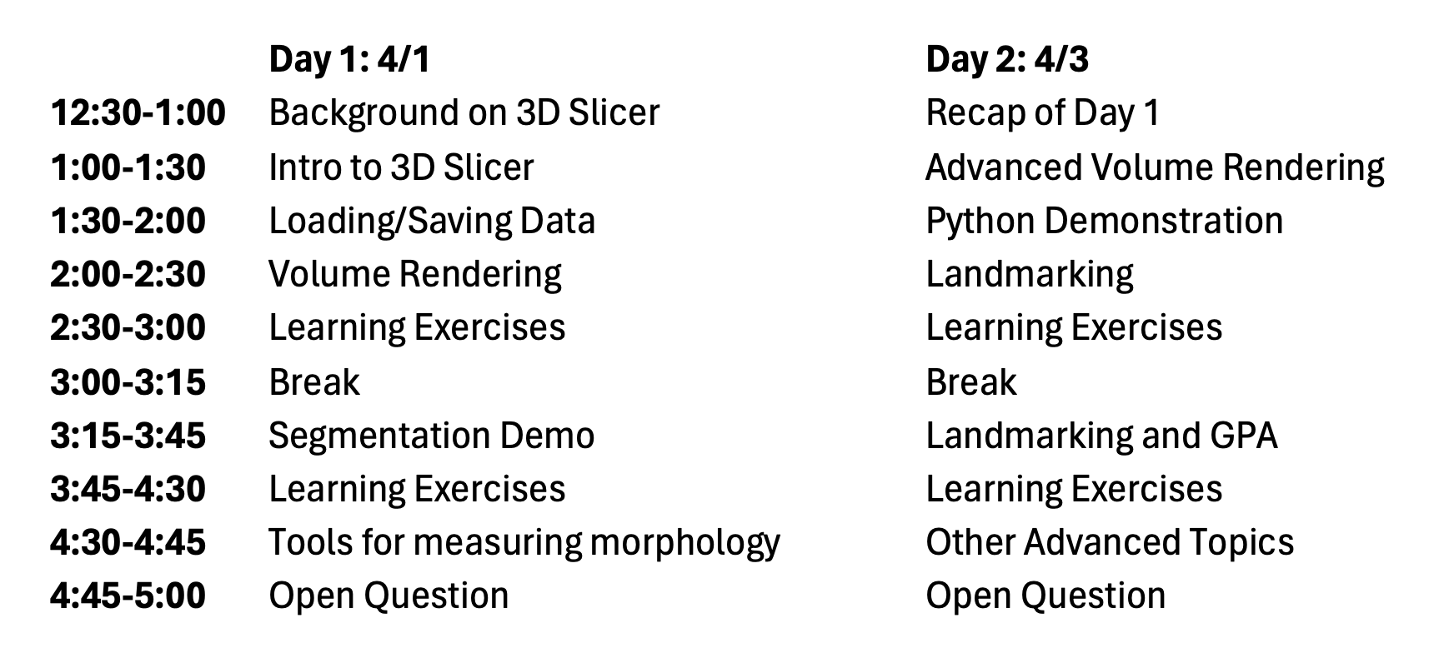
Schedule

Slide 4
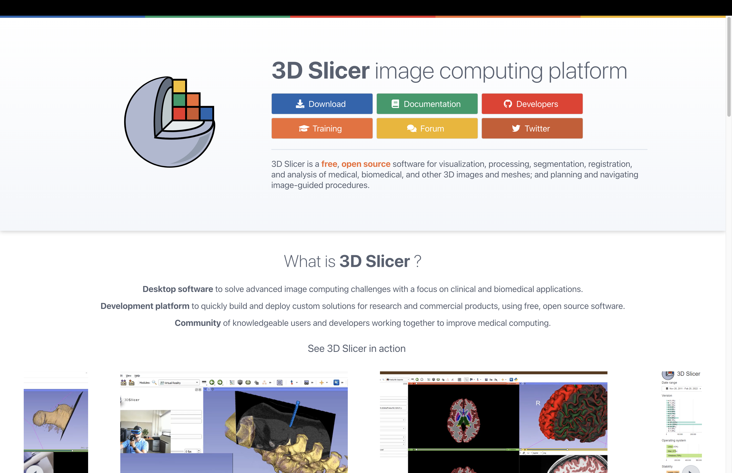

Slide 5
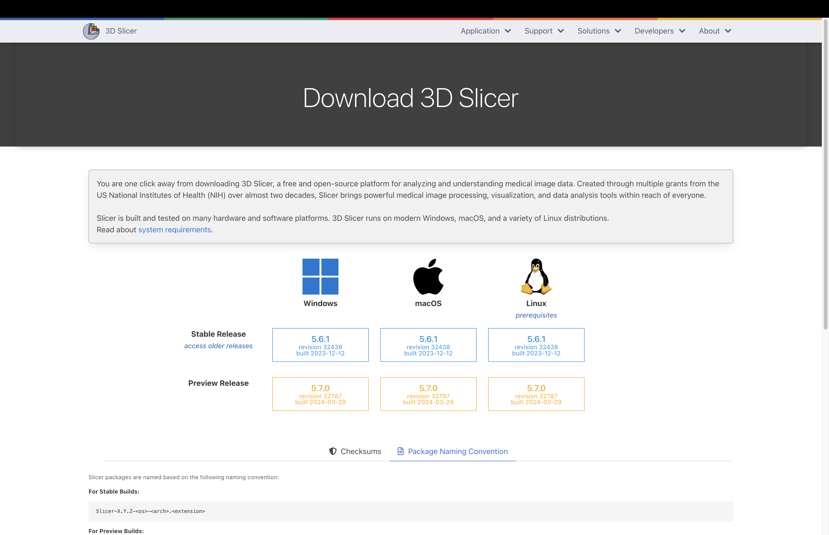

Slide 6
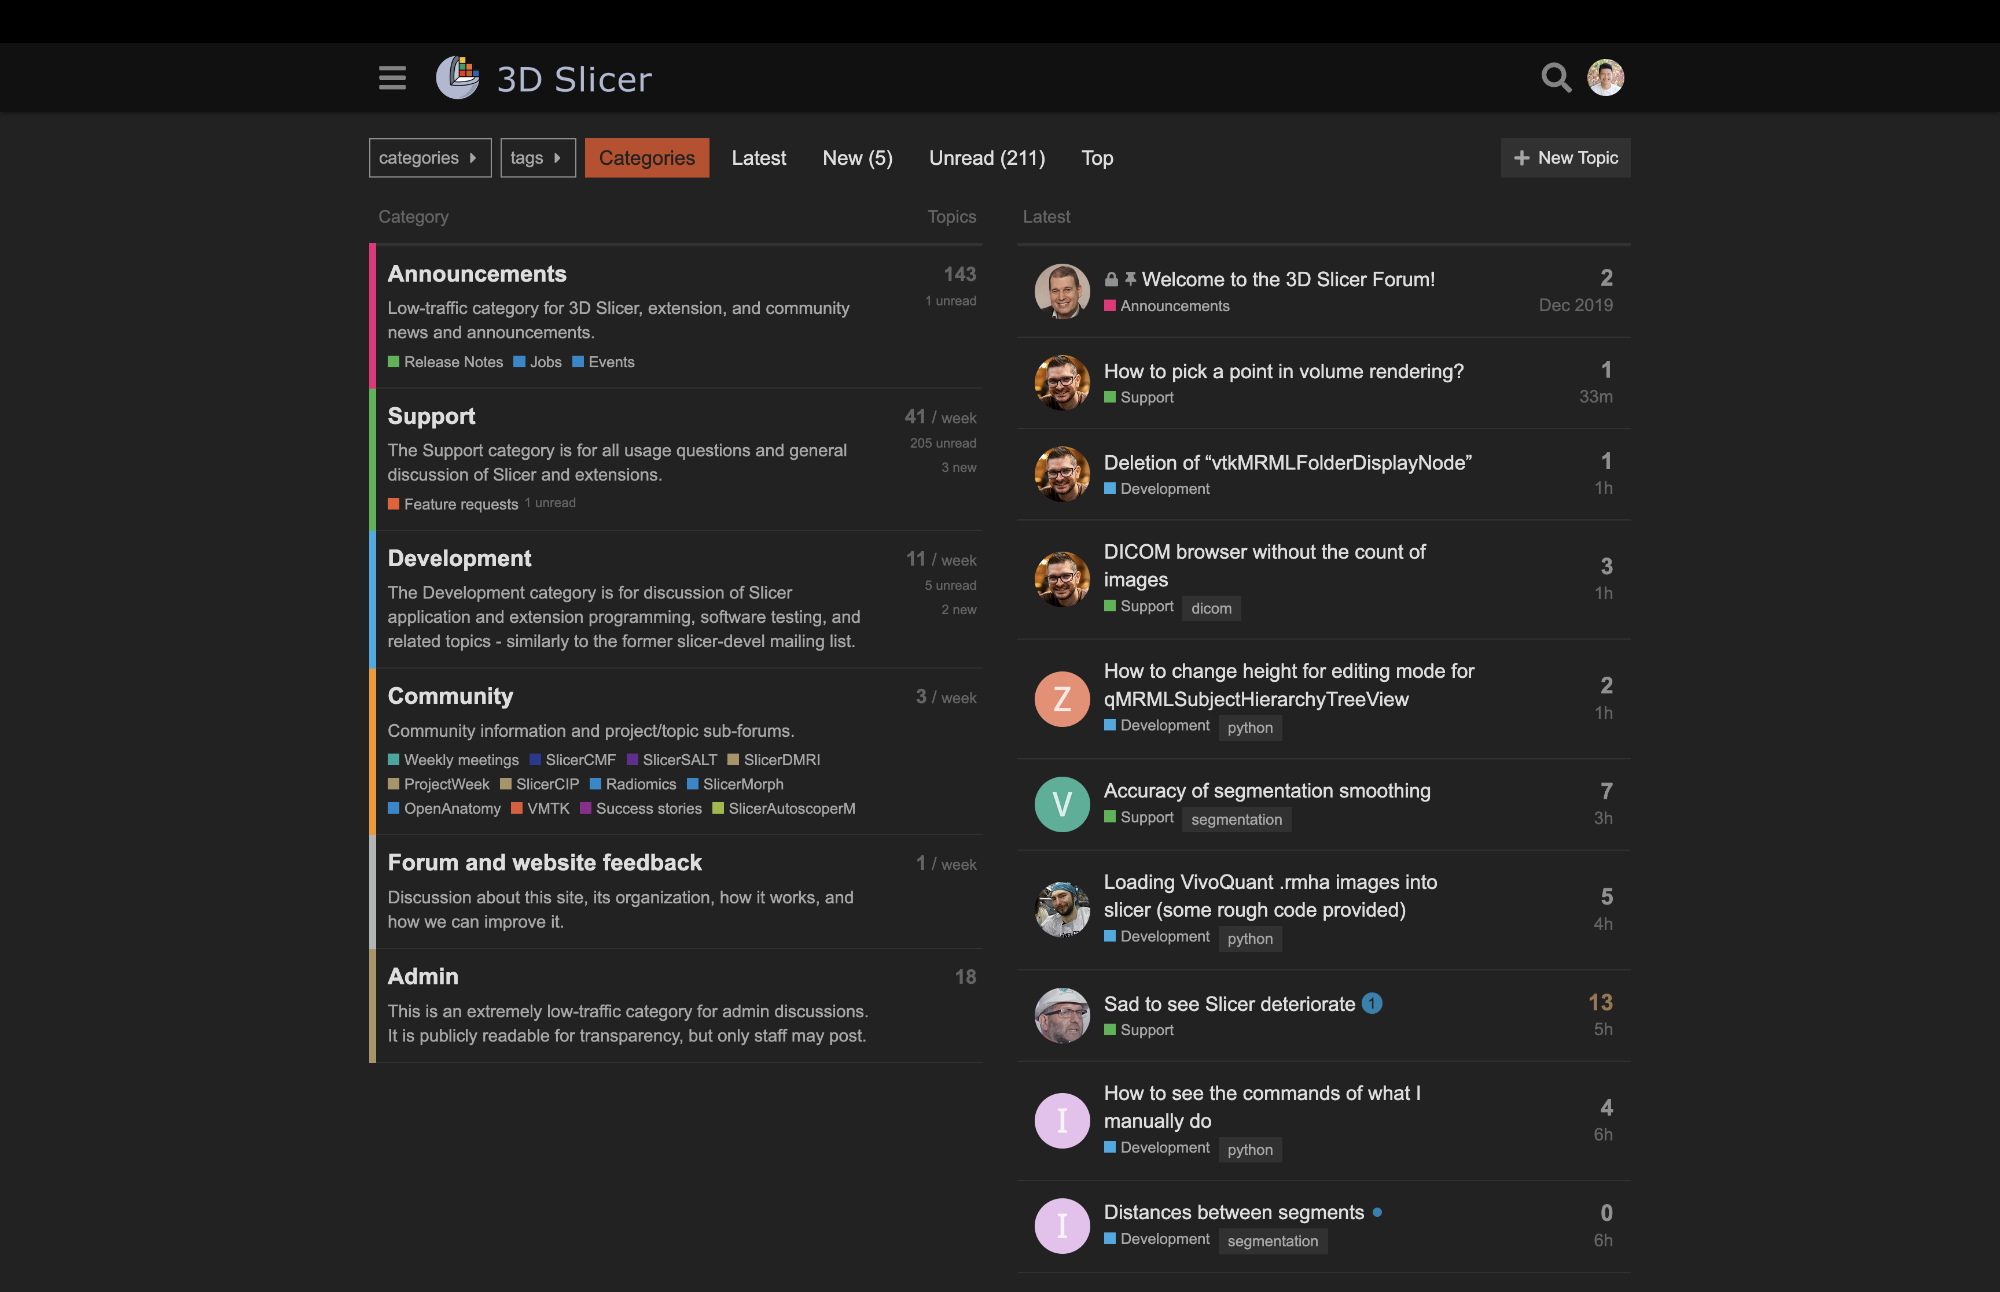

Slide 7
3D Slicer Terminology
Scene – a project repository with a collection of data nodes
Commonly saved as a .mrml or .mrb file
This is the file you load up to resume a saved project
Node – any object or data set loaded into the scene (i.e., volume, segmentation, point list, etc.)
When saving, you save the scene and the individual data nodes
Module – An independent “tool” that provides a set of functions for creating or manipulating data (i.e., Data module, Segment Editor module, Transforms module)
3D Slicer comes with 100+ built-in modules with many more available to download
Extension – A collection of related modules that can be downloaded and installed into 3D Slicer using the Extensions module

Slide 8
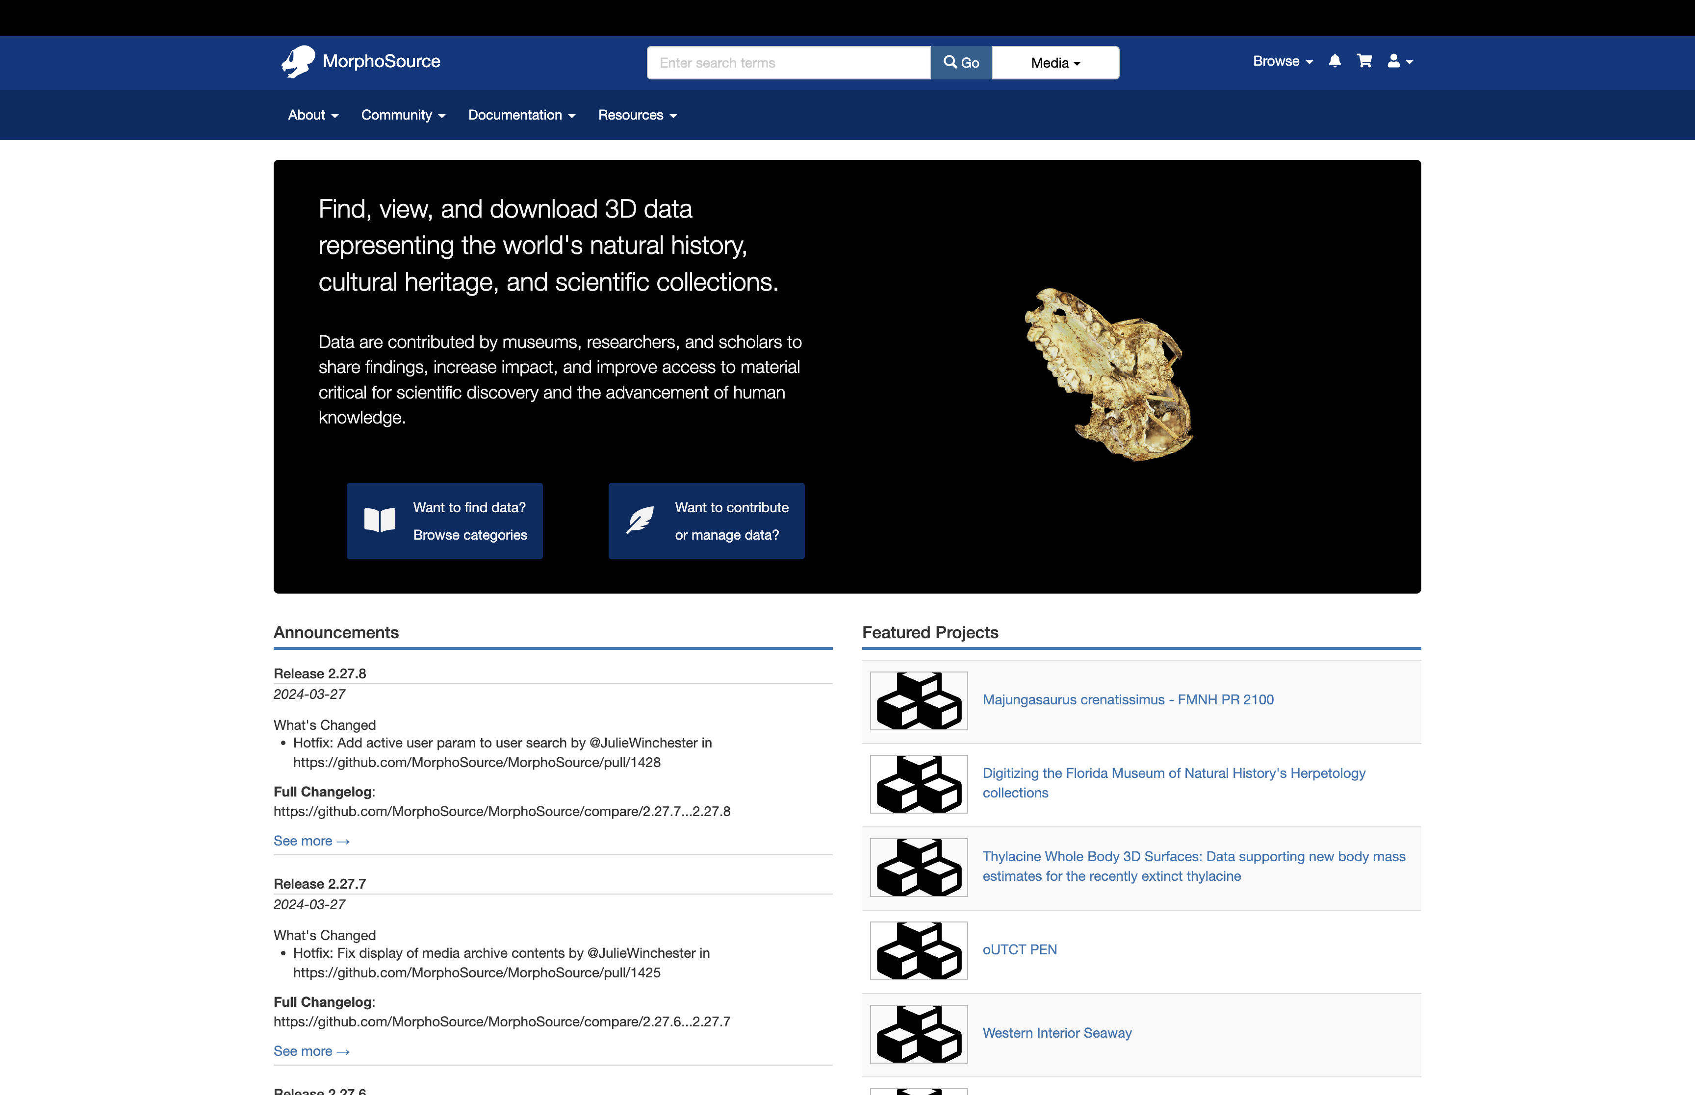

Slide 9
Computed Tomograph (CT) Terminology
CT scanning – a method of combining x-ray imaging and computer technology to generate cross-sectional images of an object
Image Stack – a series of black and white cross-sectional images that contain computed-tomography data
Common formats are standard image formats (.png, .jpg, .bmp, .tif ) or DICOM (.dcm)
Volume Node – image stacks are represented as a scalar volume node
Saved as a .nrrd file
Voxel – a 3D pixel with XYZ dimensions
Image Spacing - the resolution of a CT scan; aka the XYZ dimensions of a voxel
Needed to take accurate measurements from CT scans
Isotropy vs Anisotropy – isotropic data have the same image spacing in the XYZ directions; but when they differ the data is anisotropic
Anisotropy in the Z dimension is common for a lot medical CT scans

Slide 10
Computed Tomograph (CT) Terminology
Volume Rendering – a 3D visualization of the volume node
Presets can be used to attribute grey-scale values with different colors
Can NOT be saved as a 3D model; purely for visualization
Segmenting – the annotation of voxels to delineate structures
Segmentation Node – a data node that contains multiple segments, each of which typically represents a different structure
Can be visualized in 3D, saved as a 3D model, and quantitatively analyzed
Model – a 3D surface representation of an object; in 3D Slicer it’s typically a representation of a segment
Commonly saved as a .ply, .stl, or .obj – these formats are broadly applicable outside of 3D Slicer
Models generated elsewhere can be loaded into Slicer (photogrammetry, CAD models, etc.) but BEWARE resolution

Slide 11
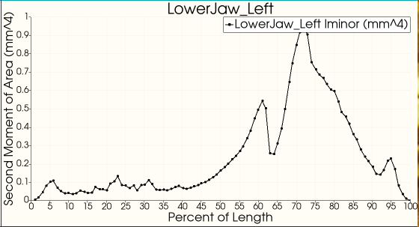
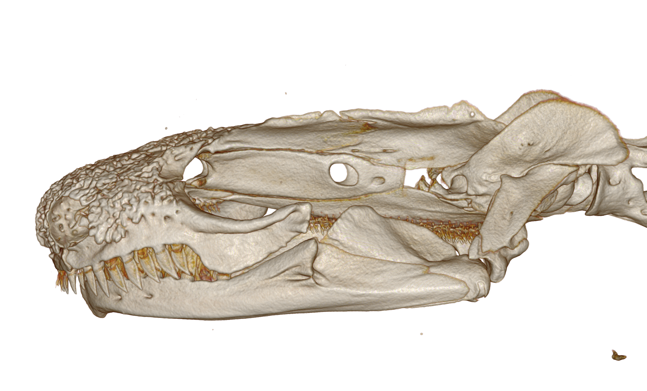

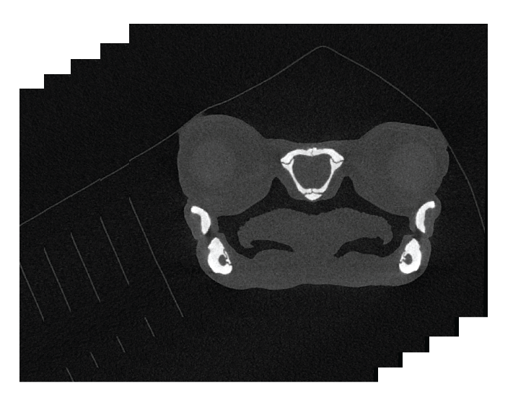
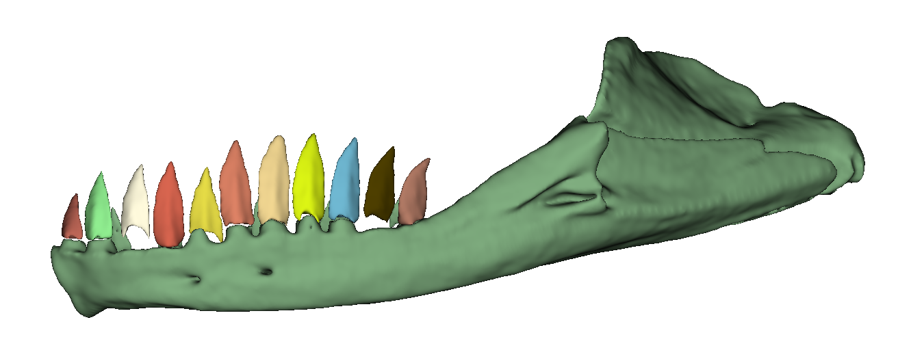

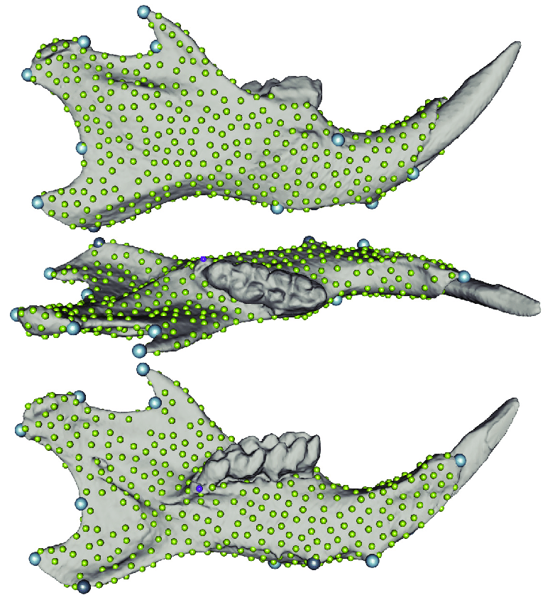
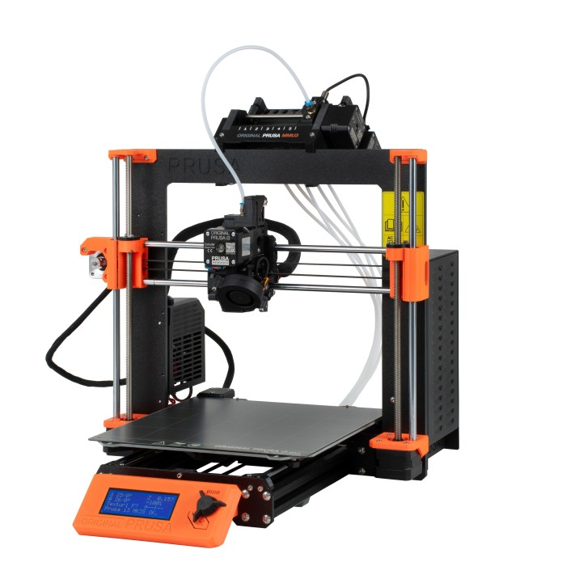
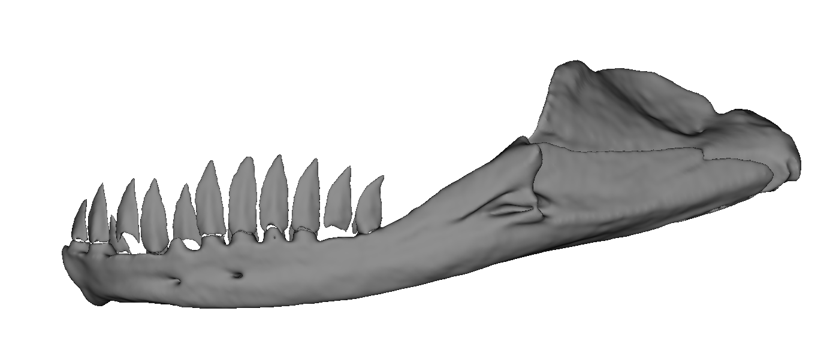
Workflow for computed tomography (CT) data
Analyze
Volume Rendering
Linear Measurements
Markups
Image Stack
3D Slicer
Segment Statistics
Volume Rendering
ImageStacks
Segmenting
Markups
Segment Editor
Segment Statistics
Markups
SlicerMorph;
Markups
Landmarking for GMM
3D Printing
Segmentations;
Data
Export to Model

Slide 12
Resources
Downloading CT Scans
Thousands of free scans on MorphoSource: https://morphosource.org
How to download from MorphoSource: https://youtu.be/SWMketCDtGc?si=rcY9x6ajZ3BxfALv
Getting help with 3D Slicer
3D Slicer Documentation: https://slicer.readthedocs.io/en/latest/index.html
3D Slicer Discourse Forum: https://discourse.slicer.org/
SlicerMorph Repository: https://github.com/SlicerMorph
Tutorials by the SlicerMorph team: https://github.com/SlicerMorph/Tutorials/tree/main?tab=readme-ov-file

